Slide 1
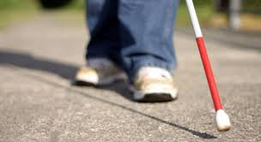
Techno-Cane *A guide for Blind
Presentation By:
Ankita Sakhuja
Ketan Lohani
Notes:
The main aim is to make visually challenged people feel more confident and independent thus enhancing their mobility.

Slide 2
Our Inspiration
Imagining a situation in which we are not able to see anything is like a nightmare for us.
Vision is recognized as a most important part of human physiology as 83% of information human being gets from the environment is via sight.
The 2011 statistics by the World Health Organization (WHO) estimates that there are 285 billion people in world with visual impairment, 39 billion of which are blind and 246 with low vision.

Slide 3
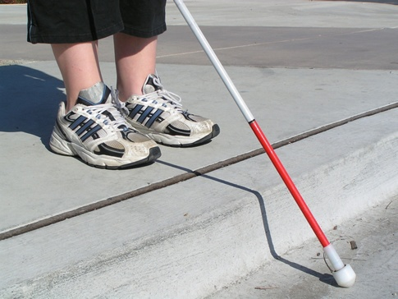
Current Technology
The traditional and oldest mobility aids for persons with visual impairments are the walking cane (also called white cane or stick) and guide dogs.
The most important drawbacks of these aids are necessary skills and training phase, range of motion and very little information conveyed.
Current system is very inefficient
Current system conveys a very little information
Scope is limited
Notes:
Almost half of the population of blind people around the world comes from India which is approximately 50 million. We want to use technology in connecting these people using Artificial Intelligence and Robotics to serve the society.

Slide 4
Proposed Technology
This research aims to provide development of better mechanisms for visually impaired.
It uses sensor units intelligently detecting the physical things integrated on a microcontroller.
Key Features-
System provides more information and guidance
User-Friendly
It is cost effective
Increases mobility
Provides flexibility

Slide 5
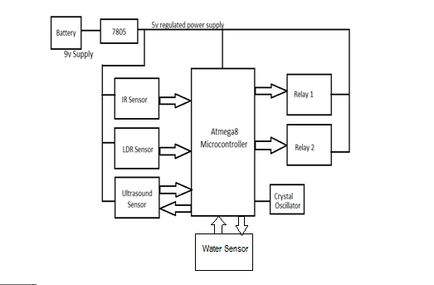
Block Diagram
Notes:
Our project has main features : Sound indicator nd alarm for any obstruction in the road.

Slide 6
Hardware Requirements
ATMEL ATMEGA 8 (an AVR based microcontroller)
Sensors
• PIR sensor –passive infrared sensors
• Ultrasonic sensor
• Water sensor(two wires)
• LDR sensor

Slide 7
..Continued
Voltage regulator
Power supply
Master board (PCB) consisting of regular components which subject to change as per the requirements.
Miscellaneous : alarm, switches, connecting wires, resistors, relays etc.

Slide 8
Software
We’ve written our code in Atmel Studio 6 for our project.
Atmel® Studio 6 is the integrated development platform (IDP) for developing and debugging Atmel ARM® Cortex®-M and Atmel AVR® microcontroller (MCU) based applications.
The Atmel Studio 6 debug your applications written in C/C++ or assembly code.
Atmel Studio 6 is free of charge and is integrated with the Atmel Software Framework (ASF)—a large library of free source code with 1,600 ARM and AVR project examples.
Notes:
ASF strengthens the IDP by providing, in the same environment, access to ready-to-use code that minimizes much of the low-level design required for projects

Slide 9
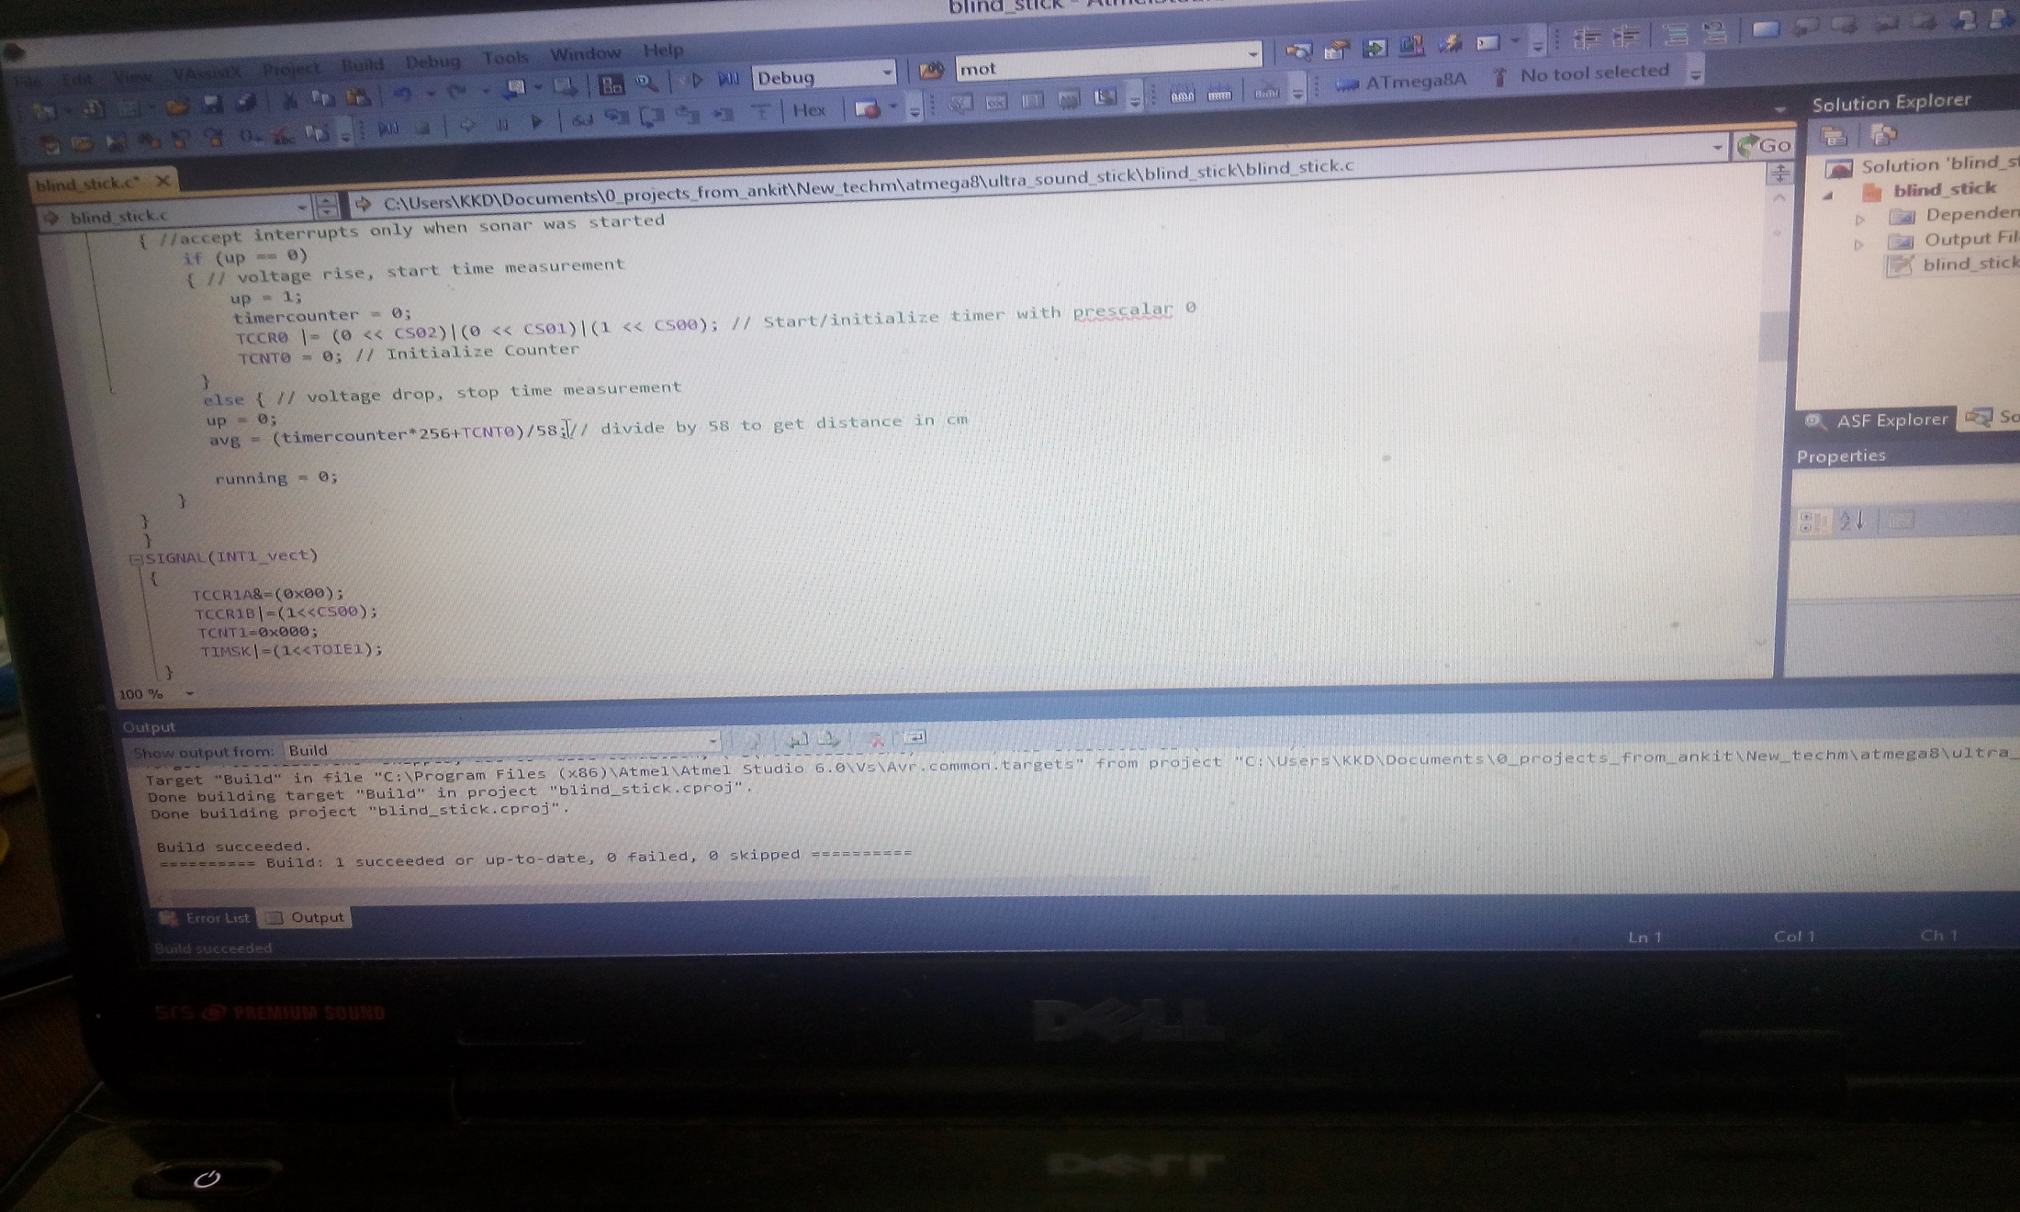
On writing the program

Slide 10
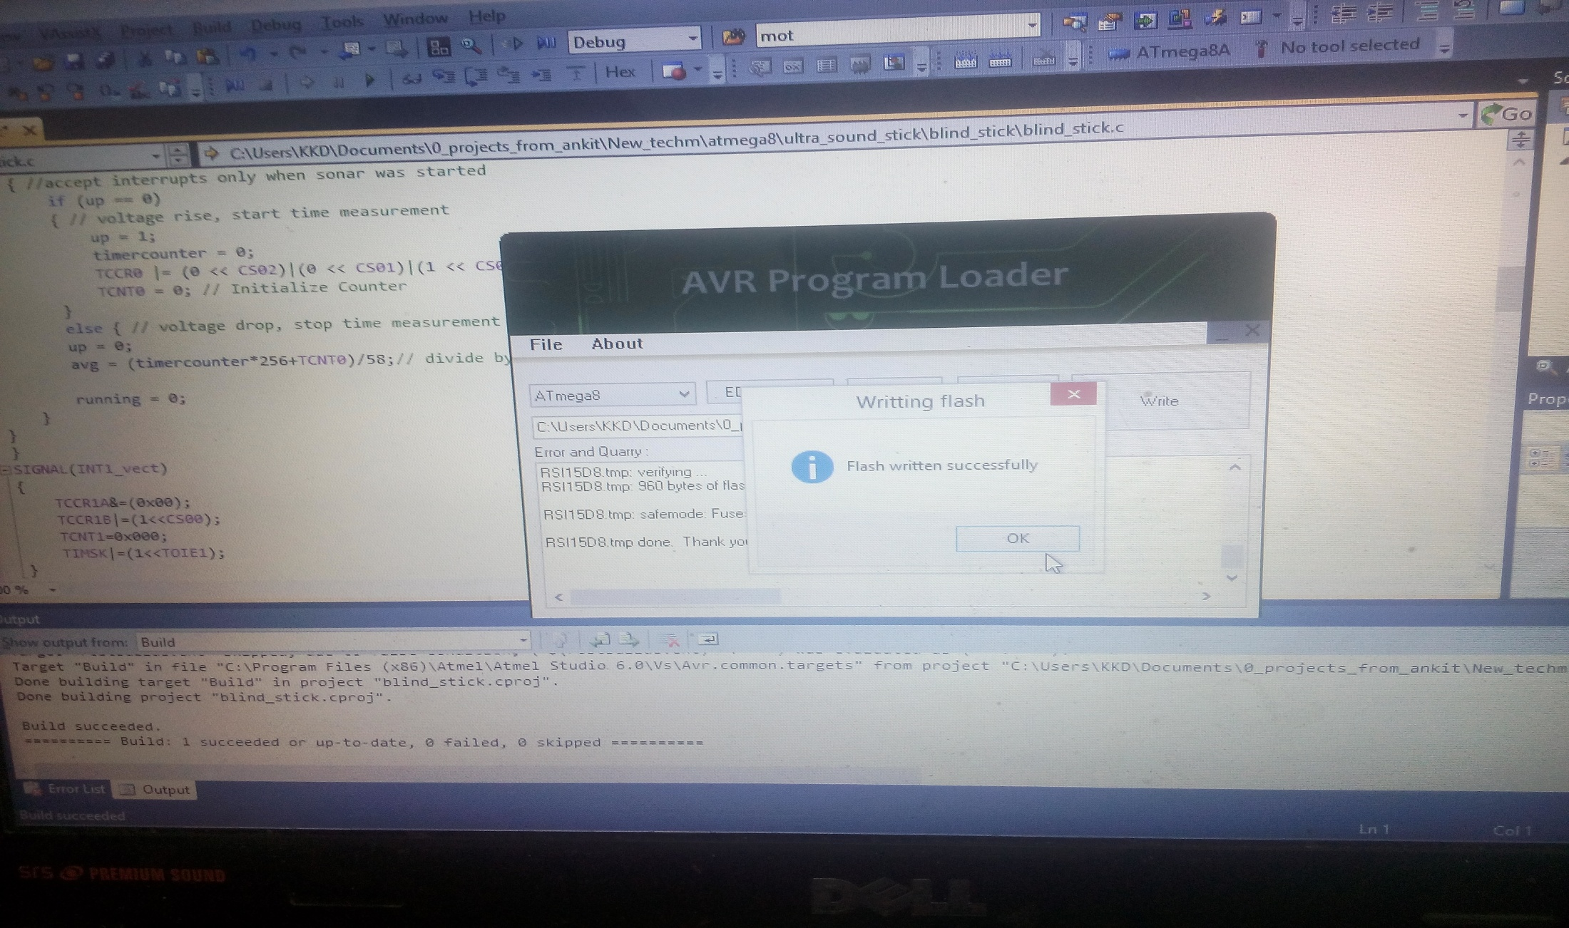
Successfully uploaded the program

Slide 11
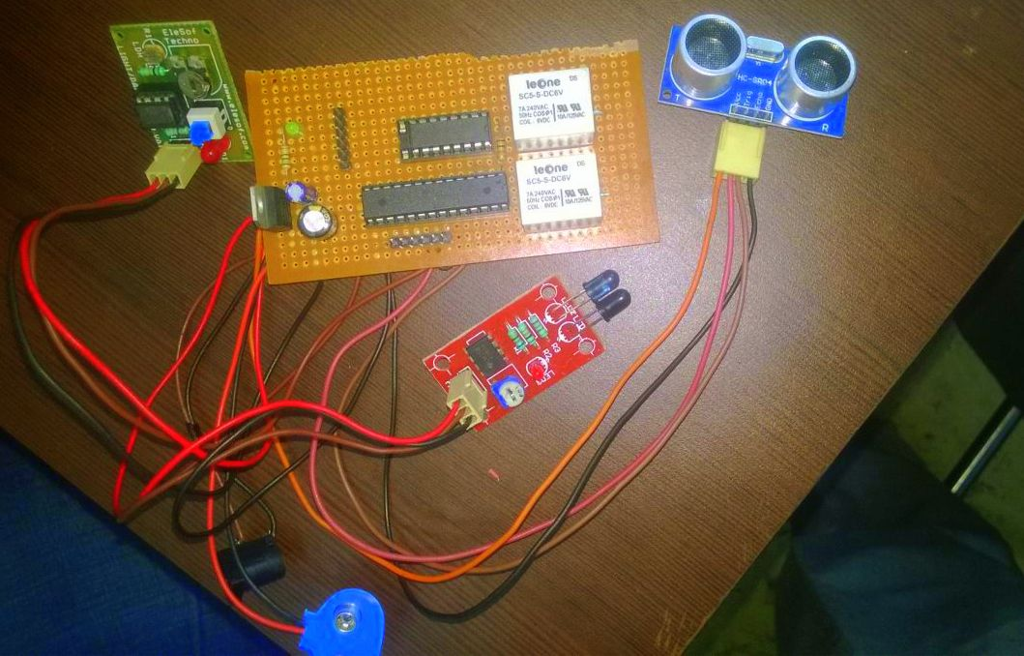
Circuit Designed

Slide 12
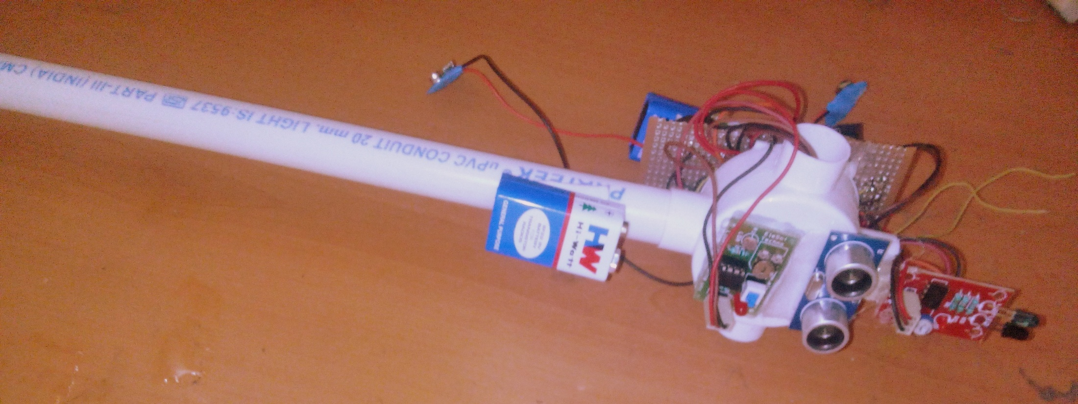
Hardware Designed

Slide 13
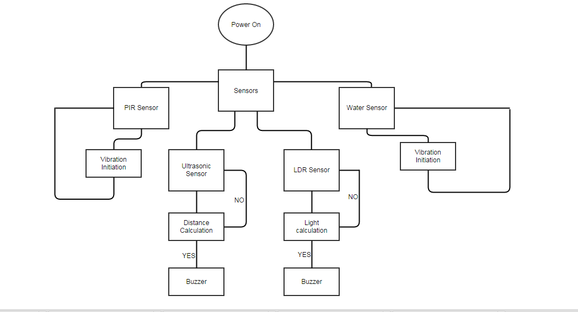
Flow chart

Slide 14
Conclusion
The benefit of the system lies in the fact that it can prove to be very low cost solution and yes, a more sensitive and efficient to millions of blind person worldwide.
Depending on the conditions satisfaction, desired work according to the specific program which is included in the report. Each sensor will control the buzzer.
We cannot give them eyes but yes, we can help them sense using our technology.

Slide 15
Future work
Further improvements in the developed system will lead to greater modifications in future. Some features that could be incorporated are:
Increasing the range of the ultrasonic sensor and incorporating a technology for determining the speed of approaching obstacles.
Provision for voice control using speech recognition.

Slide 16
References
[1] http://atmel.cc/
[2] World health Organization” Global data on Visual impairments”2010
[3]G.Gayathri, M.Vishnupriya, R.nandhini, Ms. M. Banupriya”smart walking stick for visually impaired”,IJECS,Vol.3, Issue 3,March 2014.

Slide 17
Thank You

